Slide 1
Installing SQL Management Studio 2012 at Home
CMPE 2400
Databases

Slide 2
SQL Server Management Studio 2012
This is the development environment in which we will create all of our SQL scripts.
  It is a free utility which is available for download from the Microsoft download site.
  For convenience, use the following address:
  http://www.microsoft.com/en-us/download/details.aspx?id=35579

Slide 3
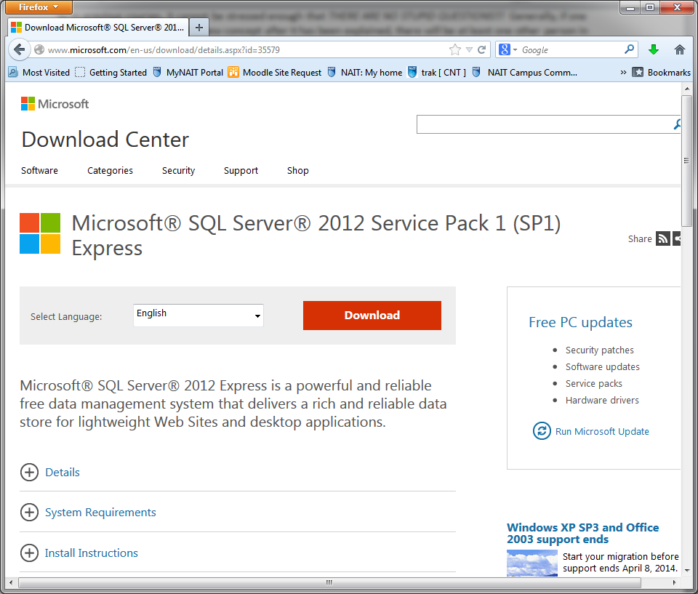
Downloading the Correct File
After navigating to the given address, you should see the following page:

Slide 4
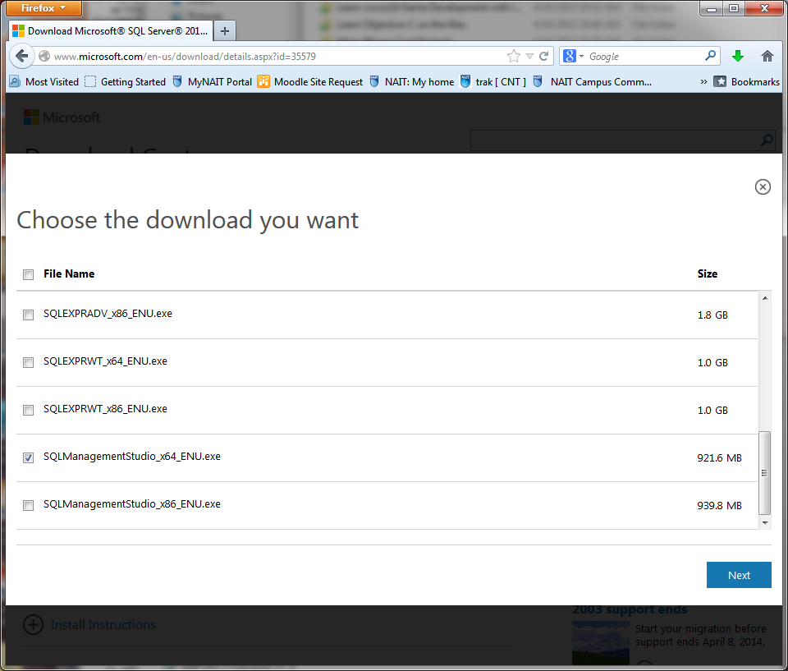
Downloading the Correct File
Upon pressing the red Download button, the following shall appear:

Slide 5
Downloading the Correct File
Scroll to the bottom of the list and choose either the x64 or x86 version of SQL Management Studio as required for your machine.
While the file is downloading, ensure that you have Visual Studio 2010 SP1 installed and up to date.
  You do NOT need a locally installed database engine / server.

Slide 6
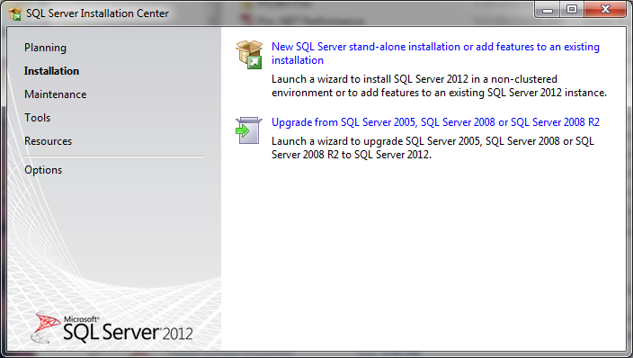
Installing Management Studio
Upon execution of the installation file, you will see the following:

Slide 7
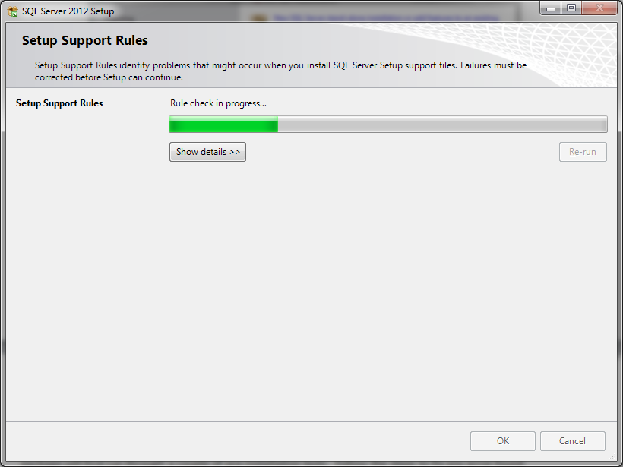
Installing Management Studio
Choose the first option from the installation menu and fix any found errors.

Slide 8
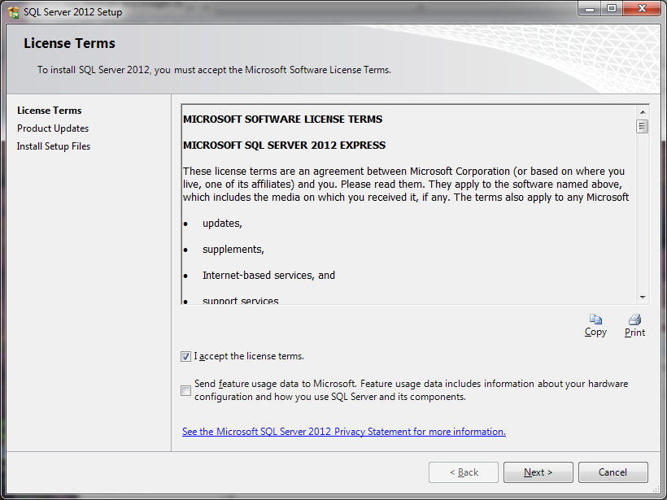
Installing Management Studio
When the following screen appears, accept the license terms… unless you have changed your mind about working at home of course…

Slide 9
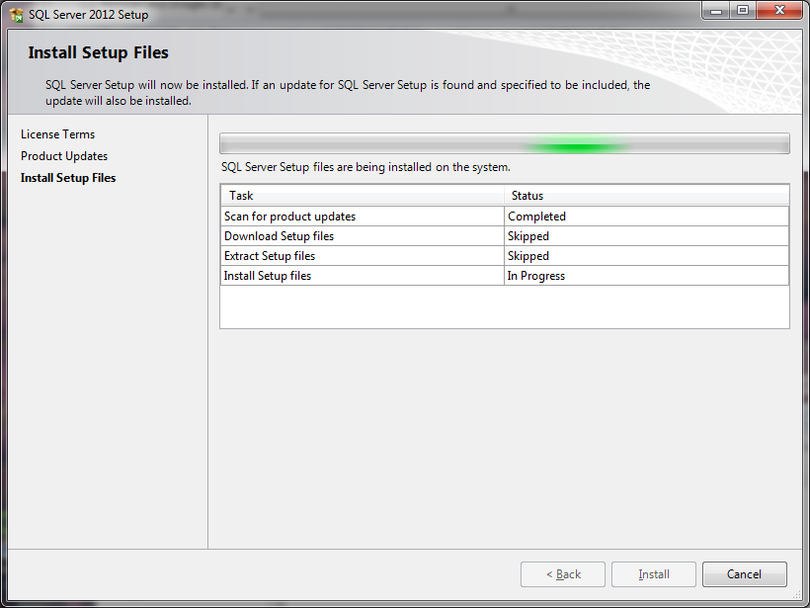
Installing Management Studio
When you see the following there should be nothing for you to do, but it may take some time so be patient.

Slide 10
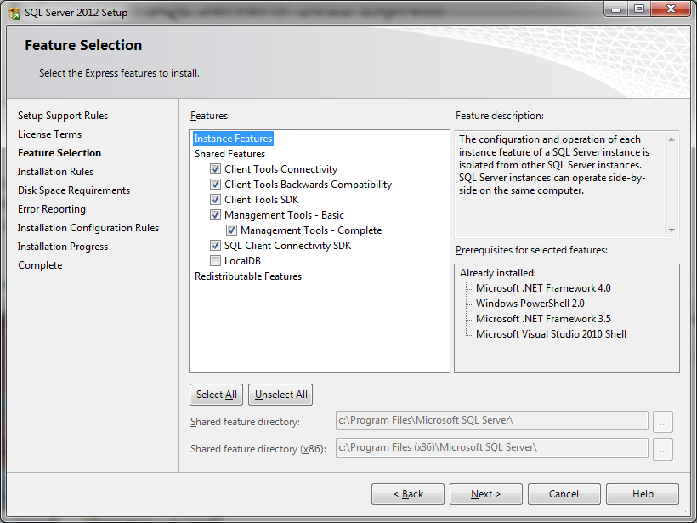
Installing Management Studio
Pressing the Next button from the previous stage will show you the following screen. Make sure the shown items are checked.

Slide 11
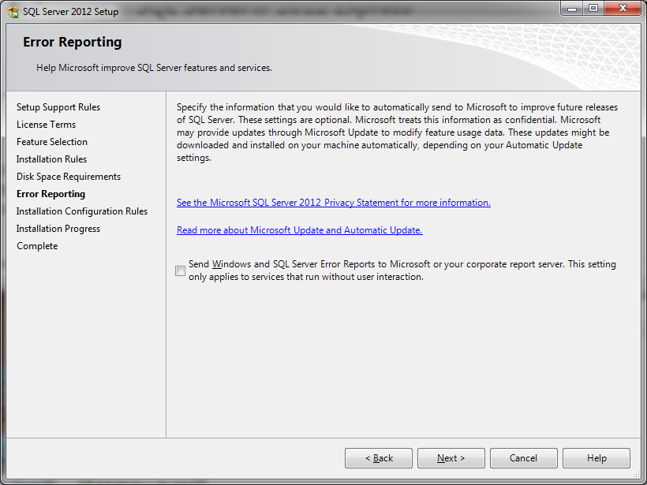
Installing Management Studio
The Error Reporting screen can be skipped.

Slide 12
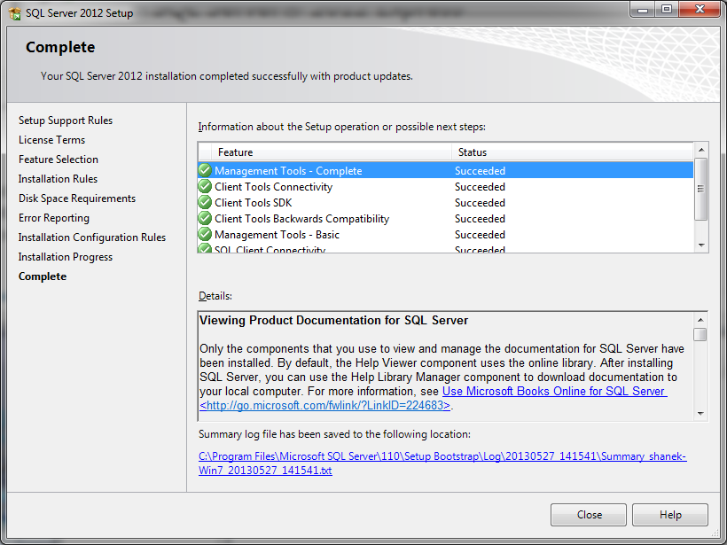
Installing Management Studio
The installation should now be progressing. Again, be patient as it can take quite some time and even seem like the application has hung up. Worry not, as you will eventually see the following:

